Slide 1

30 Million E-commerce Data Analysis Report
JR Academy
Data Analyst - Helena Li

Slide 2
Report Content
Business Purposes
30 Million Sales Data Exploration
Data Clustering
Recommendations

Slide 3
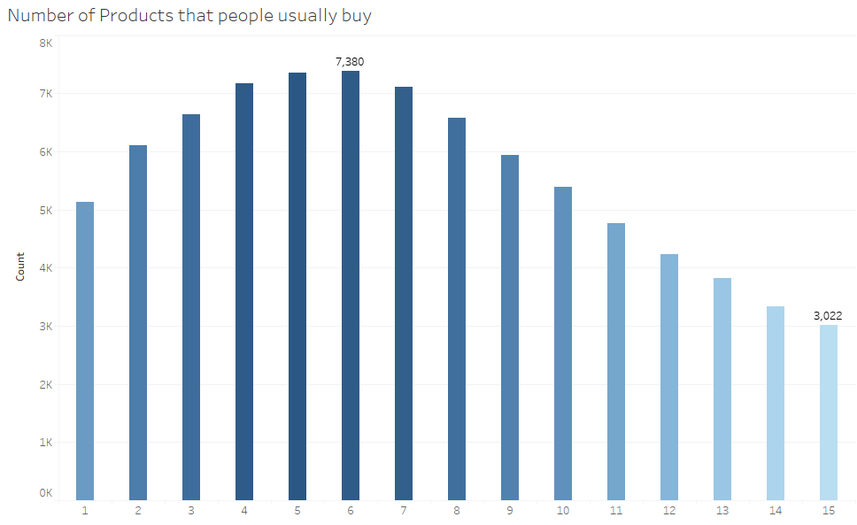
Data Exploration -Number of products that people usually buy

Slide 4
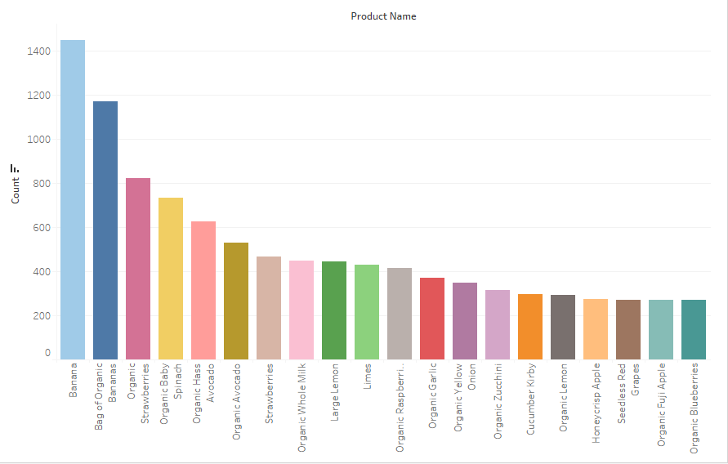
-Popular Products

Slide 5
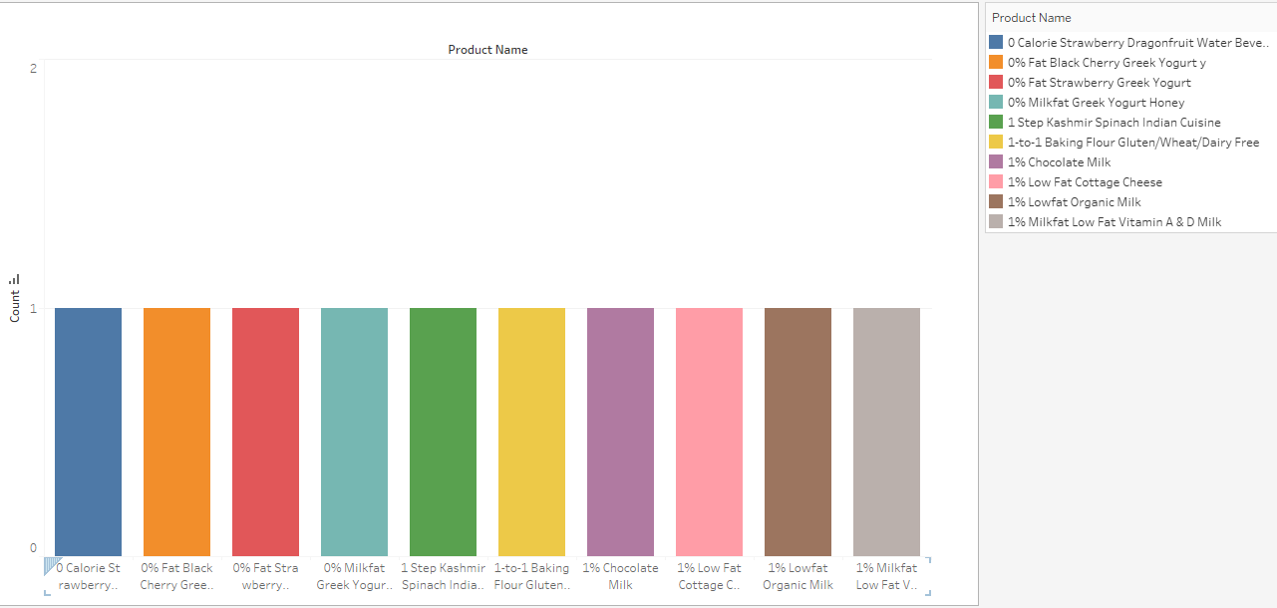
Unpopular products

Slide 6
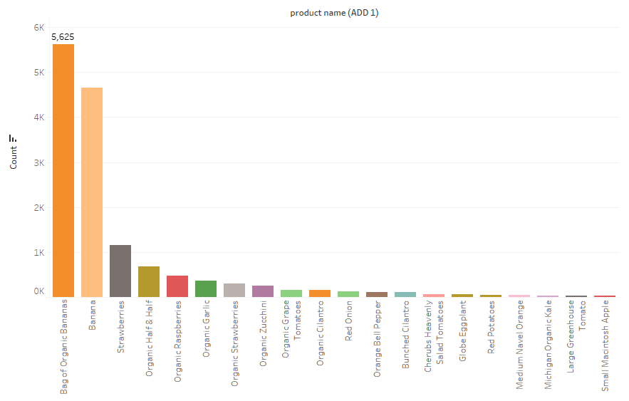
-Popular Product when add to cart is 1

Slide 7
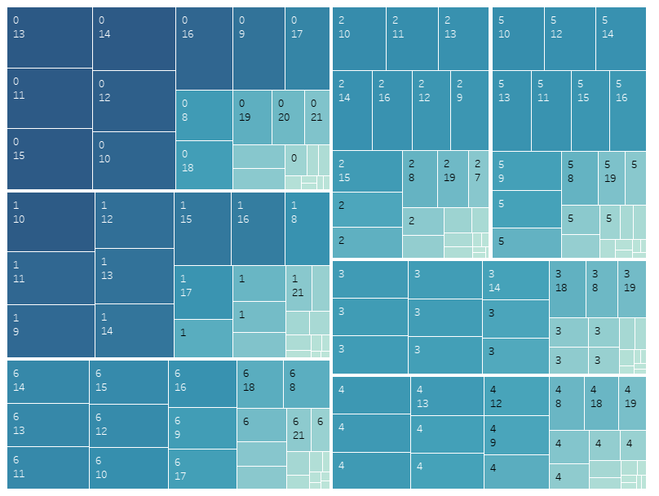
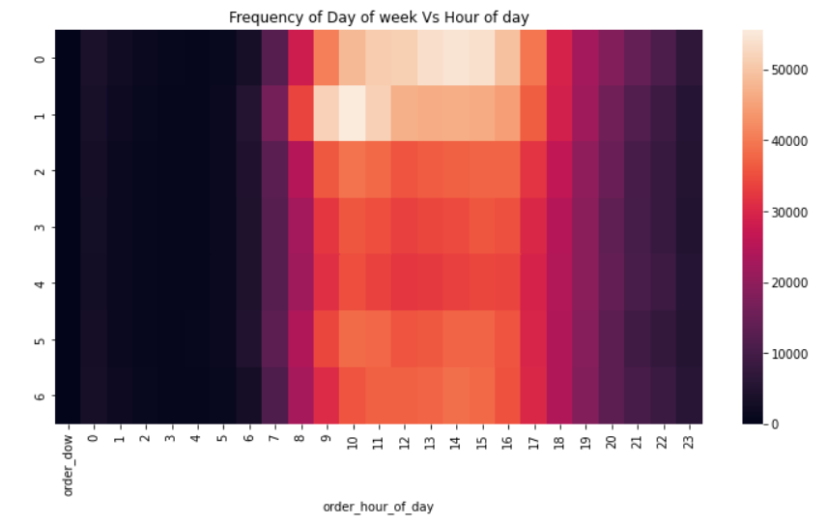
-Heatmap for order dow and hour of time

Slide 8
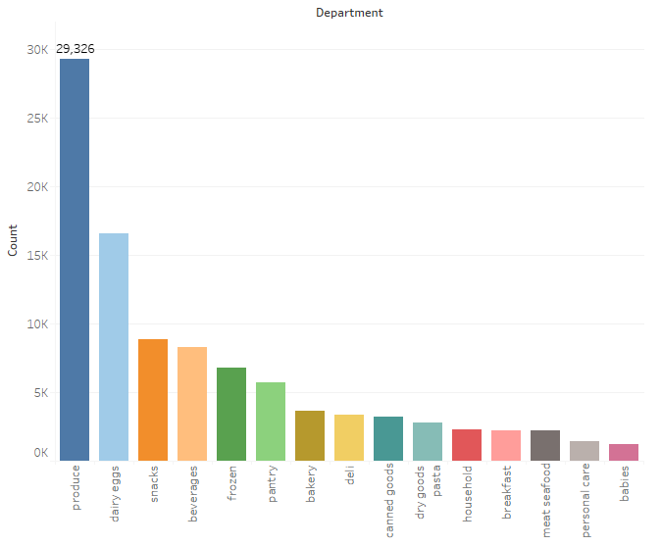
-Popular Departments

Slide 9
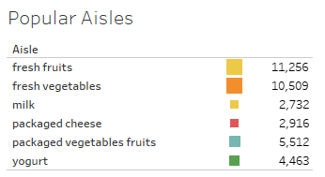
-Popular Aisles

Slide 10
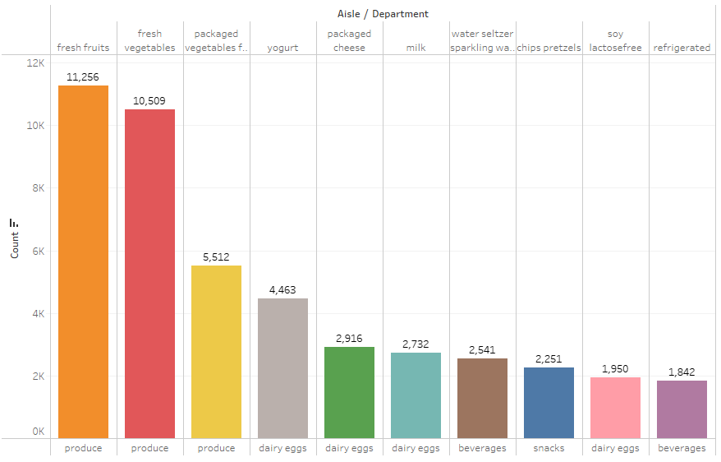
-Best Selling Aisles over All Departments

Slide 11
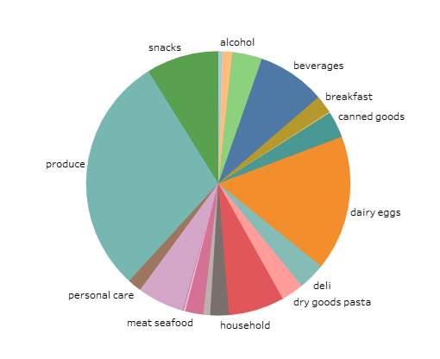
-Department Distribution

Slide 12
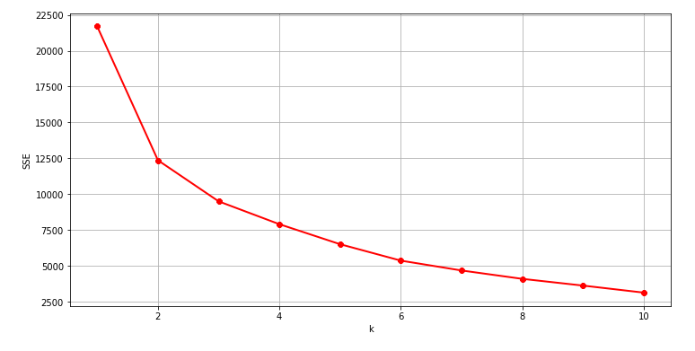
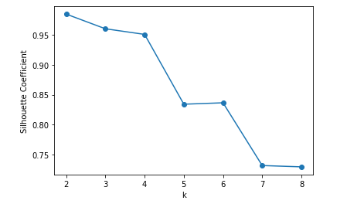
Data Clustering -Elbow Method
-Silhouette_Score Analysis

Slide 13
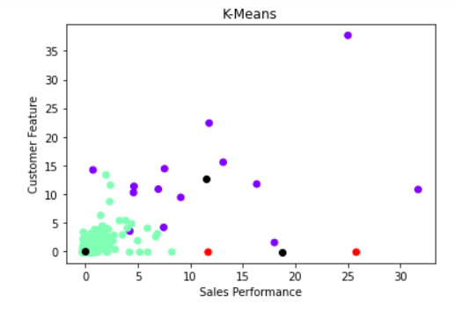
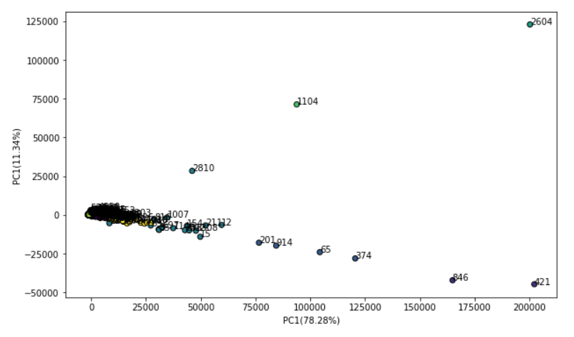
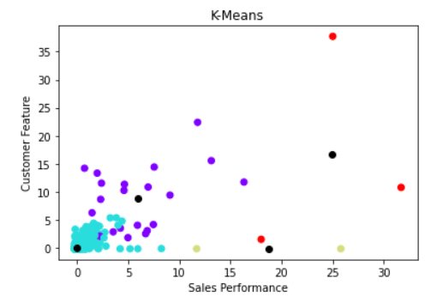
Data Clustering -PCA

Slide 14
Business Recommendations
Increase storage and price of popular products like banana, bag of organic banana
01
Increase product categories in produce department
02
Ensure popular products’ storage in peak order time (increasing company’s order channels)
03
Reduce the price and storage of unpopular products (sales promotion activity) like 0 calories strawberry dragonfruit water beverage
04
Change product manufacturer of unpopular products.
05

Slide 15
Thank You!
For more information:
Company Information: JR Academy https://jracademy.com.au/
Connect information: mingjinhelena@gmail.com

